Slide 1
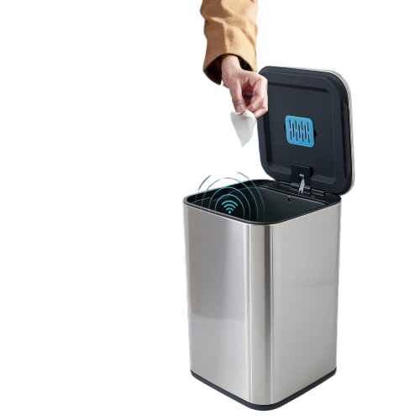
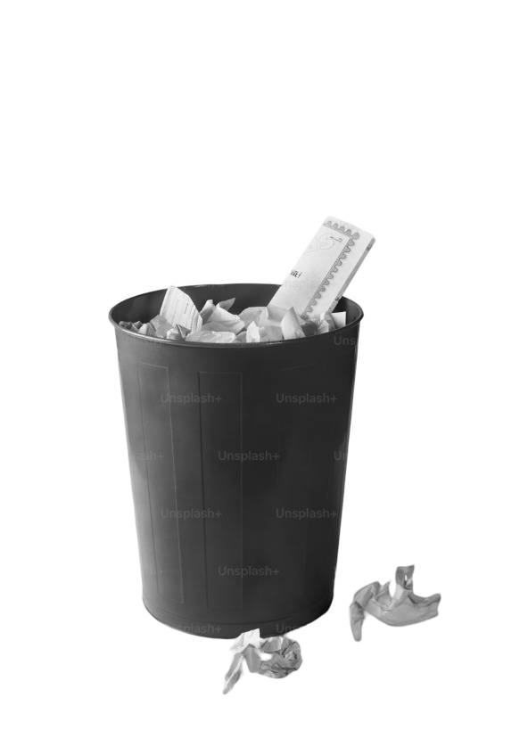
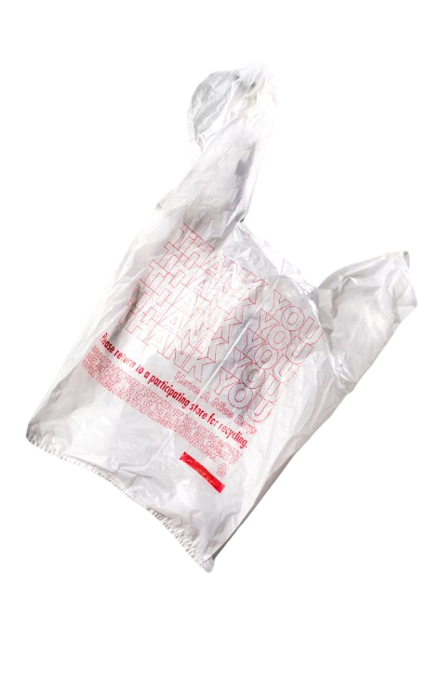

ENVIRONMENTAL STUDIES (EVS)
SMART E-DUSTBIN FOR SUSTAINABLE WASTE MANAGEMENT
ENVIRONMENTAL STUDIES (EVS)
SMART E-DUSTBIN FOR SUSTAINABLE WASTE MANAGEMENT

Slide 2
ENVIRONMENTAL STUDIES (EVS)
SMART E-DUSTBIN FOR SUSTAINABLE WASTE MANAGEMENT

Slide 3

TEAM MEMBER
JOY SAMUL
ID: 241001001188
BCS 2C
KANISHA MONDAL
ID: 241001001083
BCS 2C
SUPARNA GHOSH
ID: 241001001169
BCS 2C
RIMI SAHA
ID: 241001001029
BCS 2C
JYOTI ROY
ID: 241001001093
BCS 2C
SHOURJYA ROY
ID: 241001001179
BCS 2C
AGNIK ROY
ID:241001001181
BCS 2C
SHAYAN SAHA
ID: 241001001036
BCS 2C
ANKITA SOM
ID:241001001184
BCS 2C
CHAYAN CHOUDHURY
ID:241001001103
BCS 2C

Slide 4
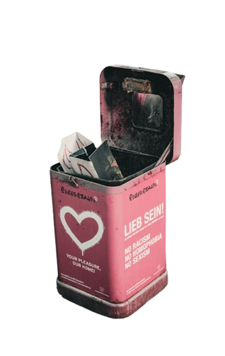
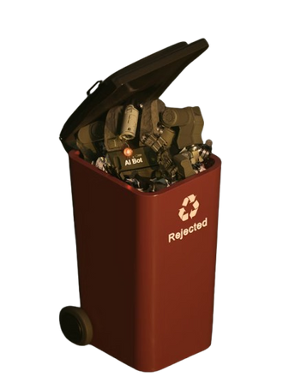
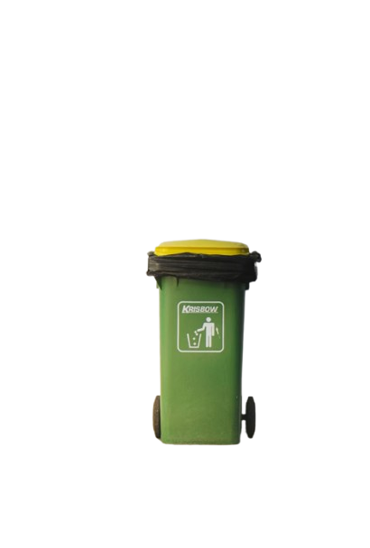
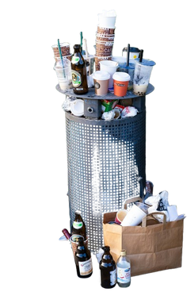
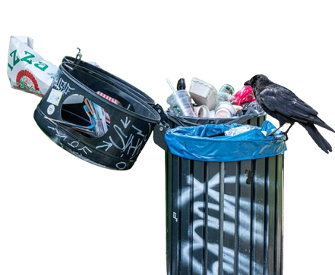
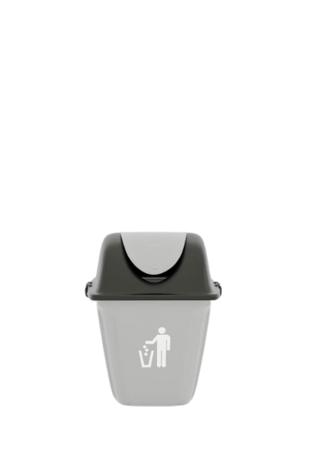
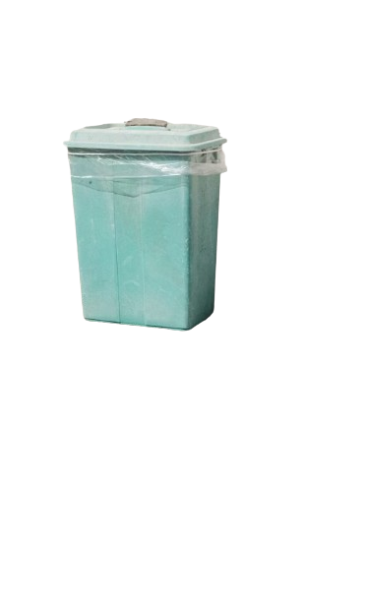
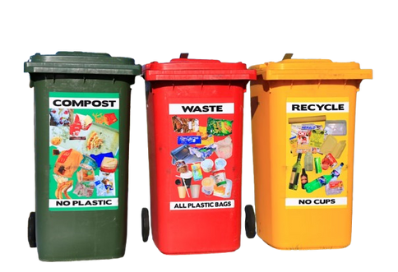
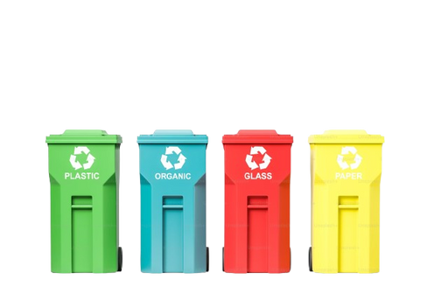
Background
  Due to rapid urbanization and increasing population, waste generation has increased drastically.
  Traditional waste collection methods are inefficient—dustbins often overflow because they are not monitored regularly.
  Overflowing bins result in foul smell, diseases, mosquito breeding, roadside littering, and environmental degradation.
  Manual monitoring of bins requires time, labour, and cost.
  Technology-based systems like E-Dustbins can improve waste handling by providing automation and real-time monitoring.
  This project aims to create a smart dustbin that promotes a cleaner and greener environment.

Slide 5
Literature Review
Research studies and previous projects highlight the need for automated waste systems:
1.Ultrasonic-sensor-based bins
Used to measure the level of trash inside bins.
Helps in predicting when the bin becomes full.
2.IoT-based smart waste collection systems
Sends alerts to municipal authorities.
Optimizes garbage truck routes
3.Automatic lid opening mechanisms
Promotes hygiene by reducing physical contact.
Useful especially in hospitals, malls, and public places.
4.Sustainability research papers
Highlight how smart waste systems improve recycling efficiency.
Reduces pollution and saves fuel used by garbage trucks.

Slide 6
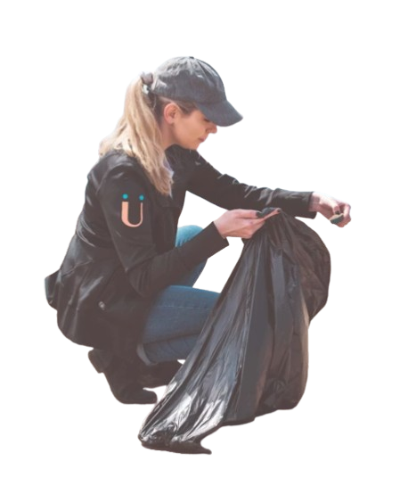
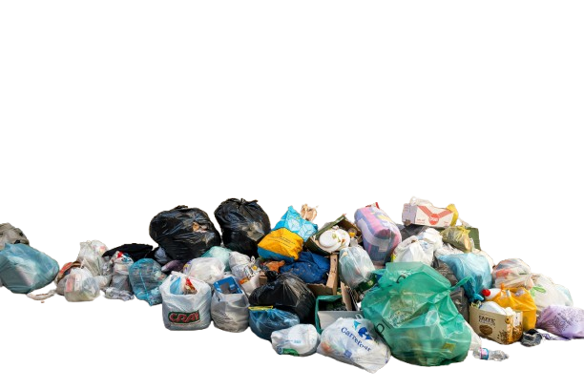
Introduction
  Waste management plays a vital role in maintaining a healthy environment.
  Proper disposal and monitoring of waste improves quality of life.
  A Smart E-Dustbin is a modern innovative approach that integrates electronics with waste disposal.
  It uses sensors to detect human presence and waste levels.
  It opens the lid automatically and gives an indication when full.
  This reduces human contact with waste, supports hygiene, and ensures better waste collection.

Slide 7

Objectives / Aims
  To design an automated dustbin that opens automatically using sensors.
  To monitor the fill-level inside the dustbin and alert when full.
  To reduce human-waste contact, thus improving hygiene.
  To promote waste segregation into wet and dry waste (optional extension).
  To encourage responsible waste disposal among citizens.
  To support smart cities by implementing intelligent waste management.

Slide 8
Need and Scope of the Study
Need:
  Growing waste generation and lack of efficient management.
  Frequent overflowing of dustbins in public places.
  Increase in infections, pests, and pollution.
  Huge workload on sanitation workers.
  Lack of awareness and improper waste disposal habits.
Scope:
  E-Dustbins can be used in schools, colleges, malls, hospitals, offices, streets, parks, bus stands, etc.
  Can be upgraded with IoT or GSM notifications.
  Useful for municipal waste authorities for organizing waste collection routes.
  Can be implemented as part of Swachh Bharat Mission and Smart City initiatives.
  Can evolve into large-scale waste management automation systems.

Slide 9
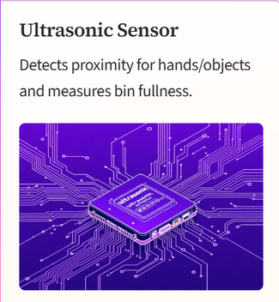

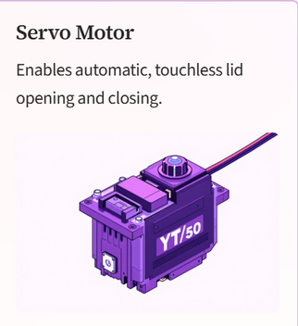
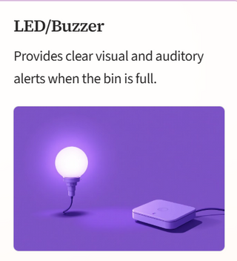
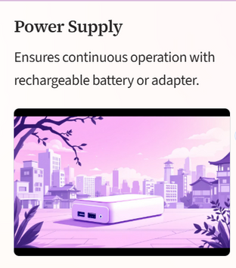
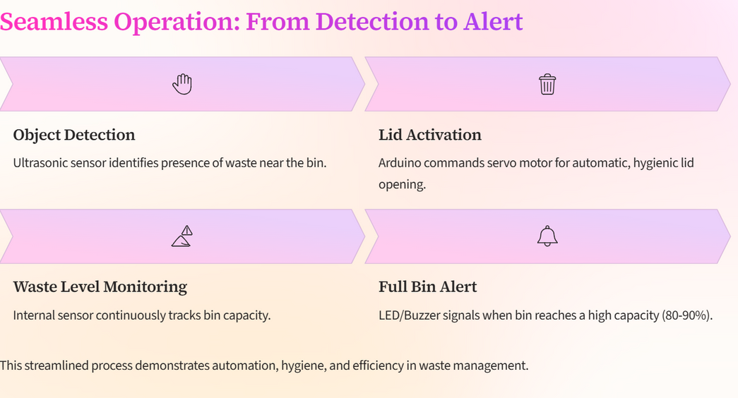
Methodology and Technical Aspects

Slide 10
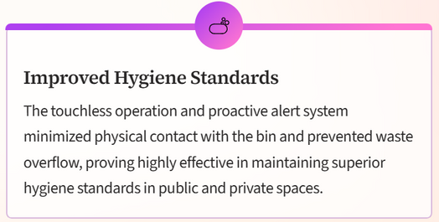


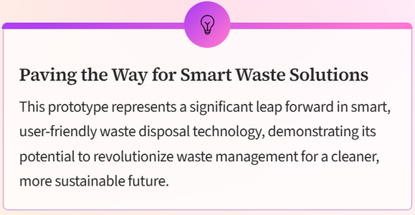
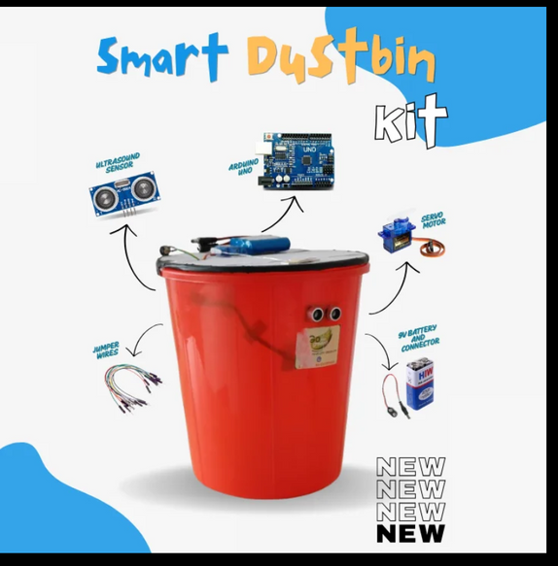
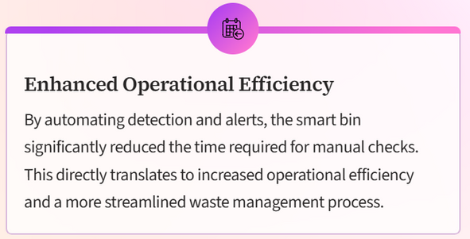
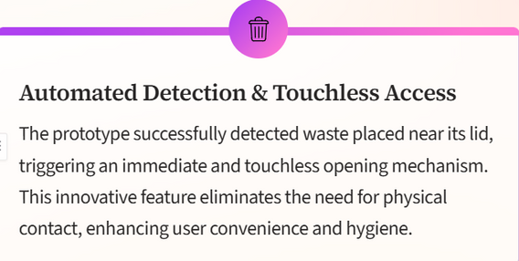
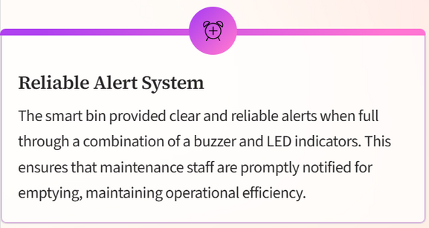
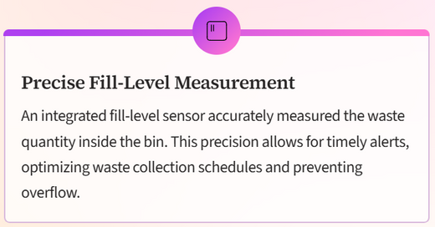
Results:

Slide 11

Way forward
  Improved Hygiene: Minimizes direct contact with waste.
  Prevents Overflow: Leads to cleaner surrounding areas.
  Reduces Pollution: Decreases chances of animals scattering waste.
  Supports Municipal Workers: Reduces manual effort and risk of diseases.
  Encourages Responsible Behavior: People are more likely to use a dustbin that is automated.
  Resource Management: Helps in efficient garbage collection and reduces fuel usage.
  Smart City Advancement: Contributes to digital and clean city initiatives.

Slide 12
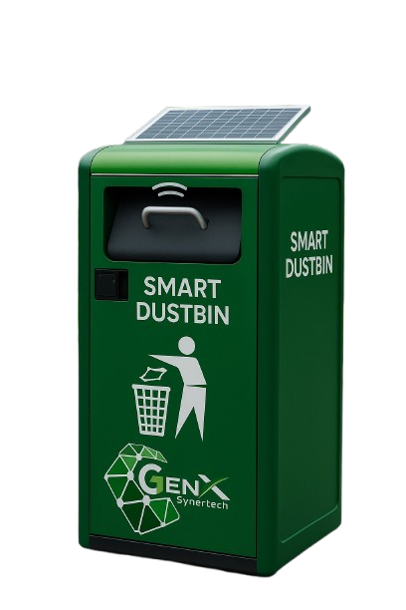
Discussion — Societal Impact
  Integrate with Internet of Things (IoT) to send waste level notifications to smartphones or municipal servers.
  Create multi-compartment bins for wet, dry, plastic, and recyclable waste.
  Add solar panels to make the system energy-efficient.
  Develop a mobile app for real-time waste monitoring.
  Implement GPS-based route optimization for garbage trucks.
  Use AI-based image recognition for automatic waste segregation in the future.

Slide 13

References / Bibliography
  Research papers on smart waste management
  IEEE papers on IoT-based dustbins
  Government websites (Swachh Bharat Mission)
  Textbooks on environmental studies
  Articles/blogs from verified environmental sources

Slide 14
Thank You
“Cleanliness is the foundation of a healthy society.”

